Slide 1
CLOUD Serverless COmputing
NAME: PRIYANKA ANNAPUREDDY
REG ID: 2000032121
SEC: 13

Slide 2
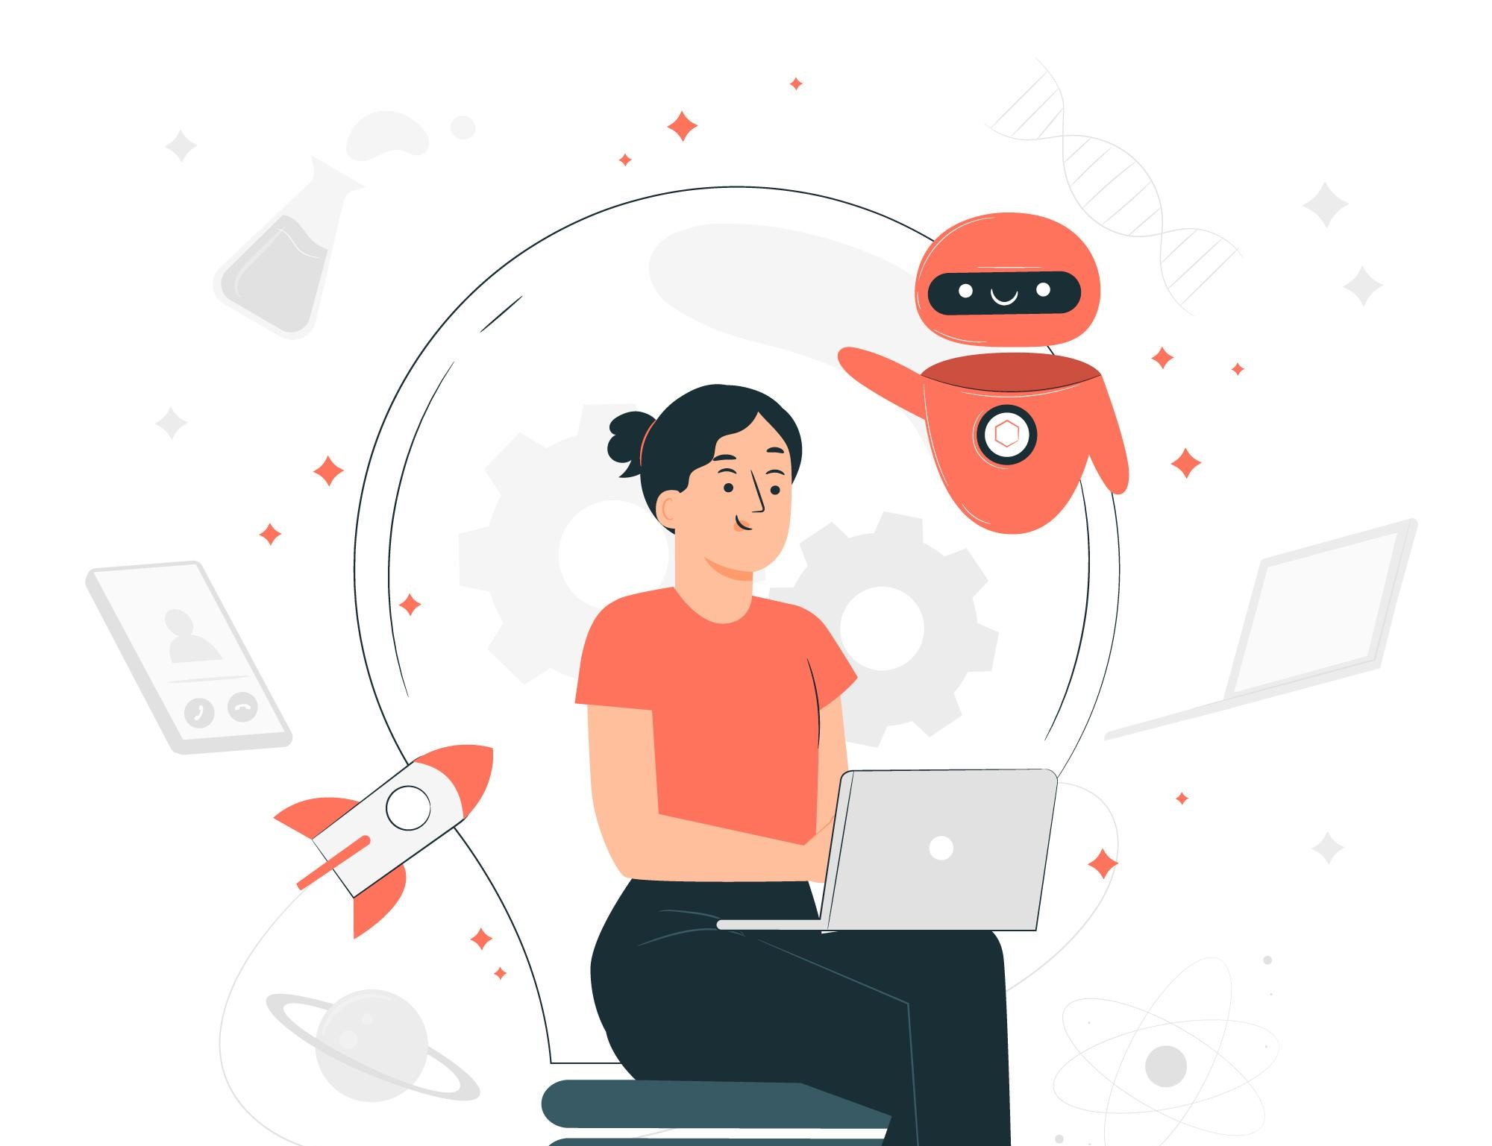

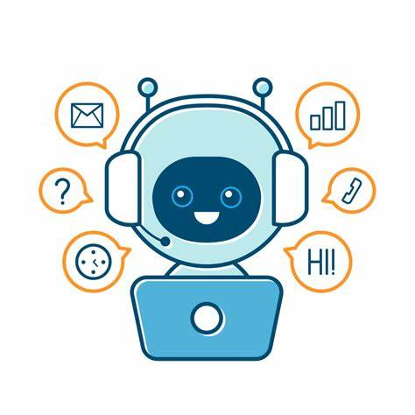
Build a serverless chatbot (voice and text) with Amazon Lex and integrate with Facebook

Slide 3
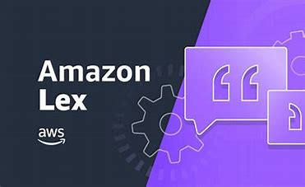
WHAT IS AMAZON LEX?
Amazon Lex is an AWS service for building conversational interfaces for applications using voice and text.
Amazon Lex provides the deep functionality and flexibility of natural language understanding (NLU) and automatic speech recognition (ASR) so you can build highly engaging user experiences with lifelike, conversational interactions, and create new categories of products.
The same deep learning engine that powers Amazon Alexa is now available to developers, enabling us to build sophisticated, natural language chatbots into our new and existing applications using the Amazon Lex.

Slide 4
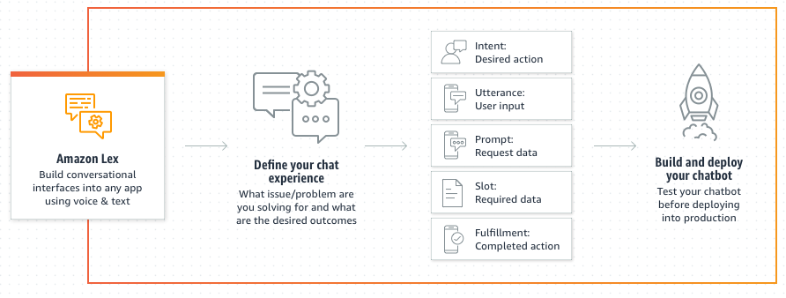
Amazon Lex is a fully managed artificial intelligence (AI) service with advanced natural language models to design, build, test, and deploy conversational interfaces in applications.

Slide 5
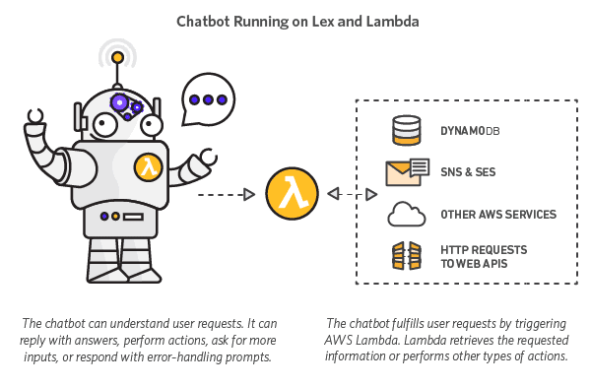
STEPS TO BUILD A CHATBOT USING AMAZON LEX
Create an Amazon Lex bot
Create a Facebook application
Integrate Facebook Messenger with your Amazon Lex bot
Validate the integration

Slide 6
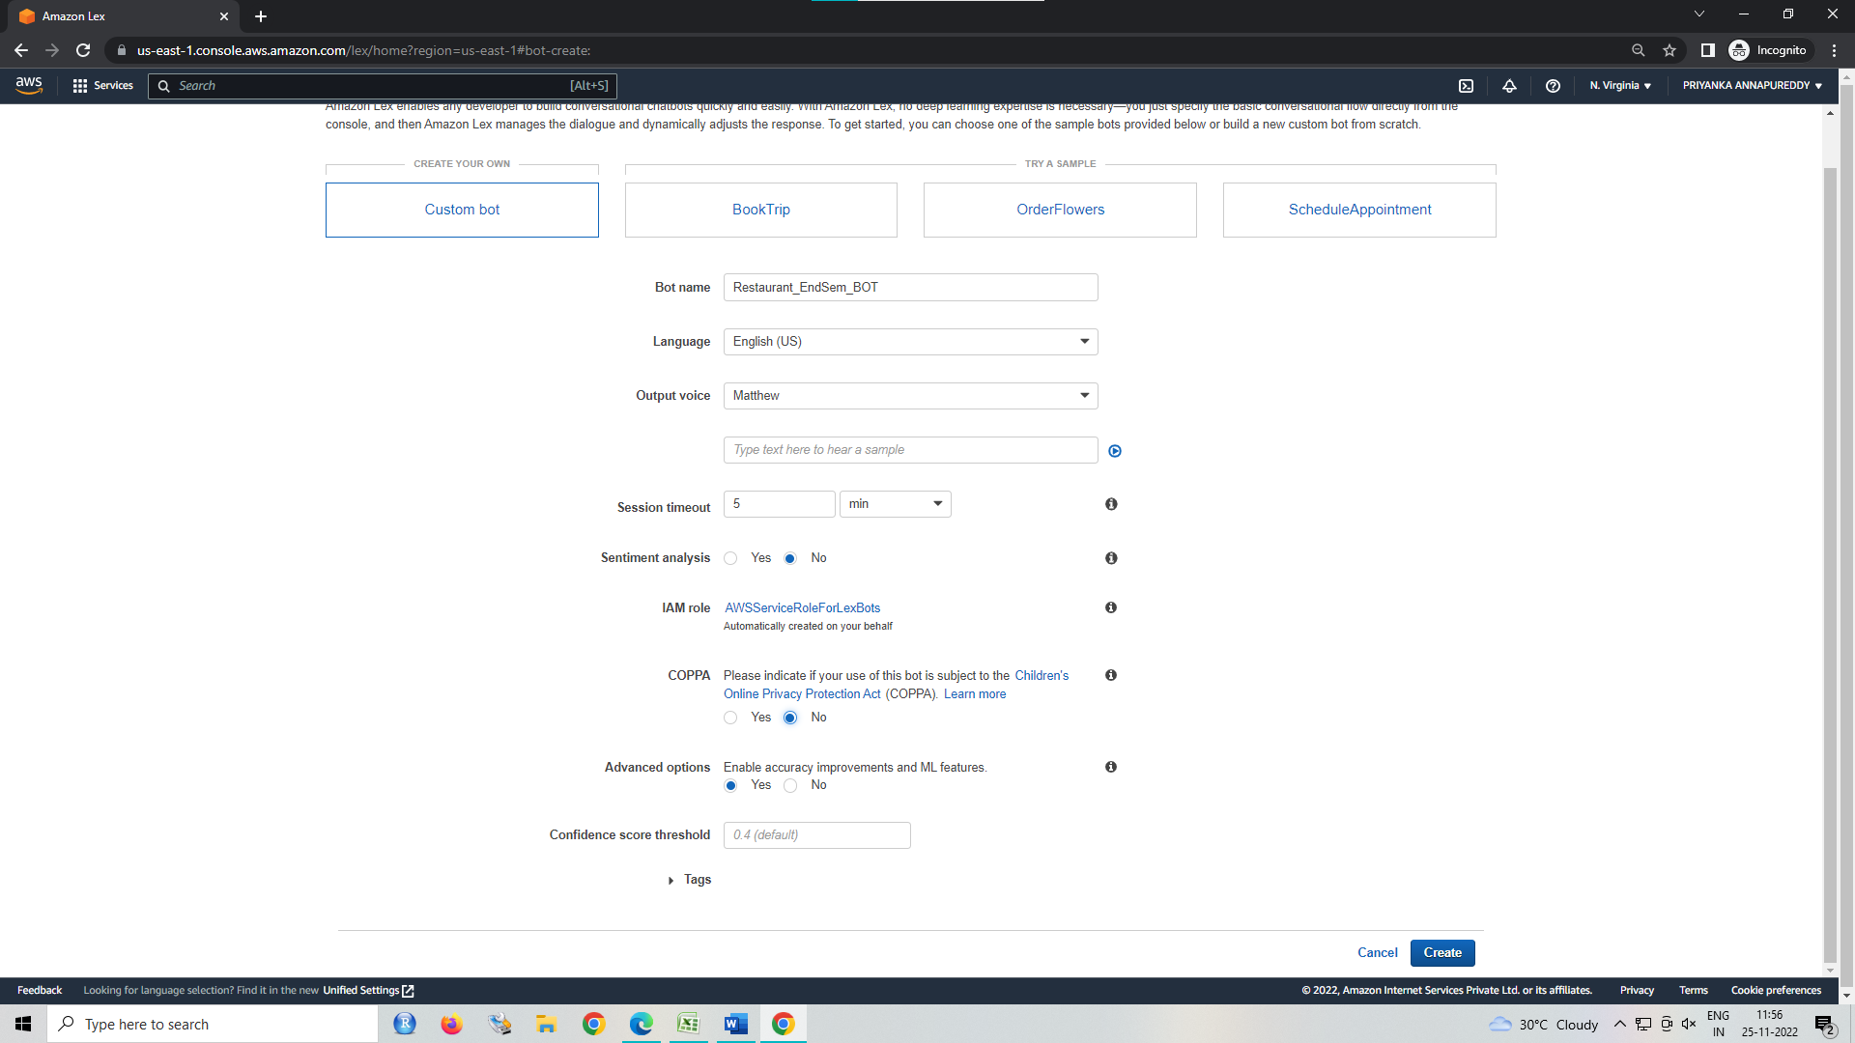
SCREENSHOTS OF CREATION:
In management console open amazon lex and click on create a bot→custom bot

Slide 7
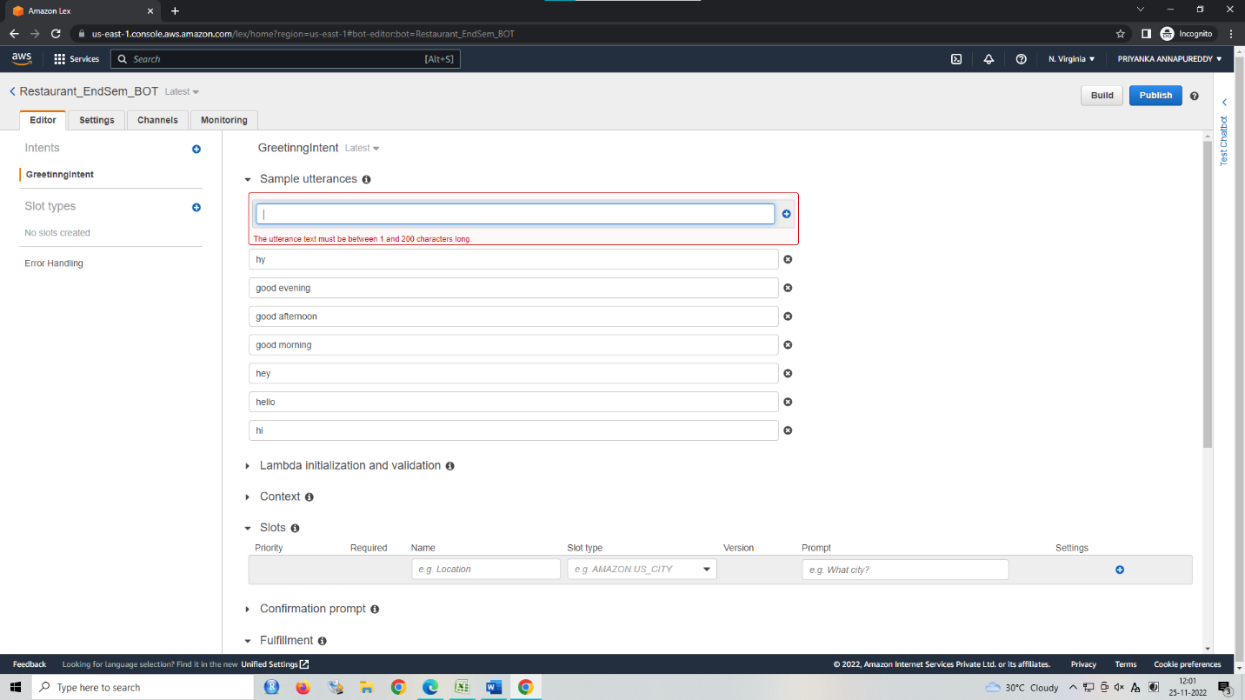
Click on create intent and give a unique name to the intent. Add sample greeting inputs given by the user.

Slide 8
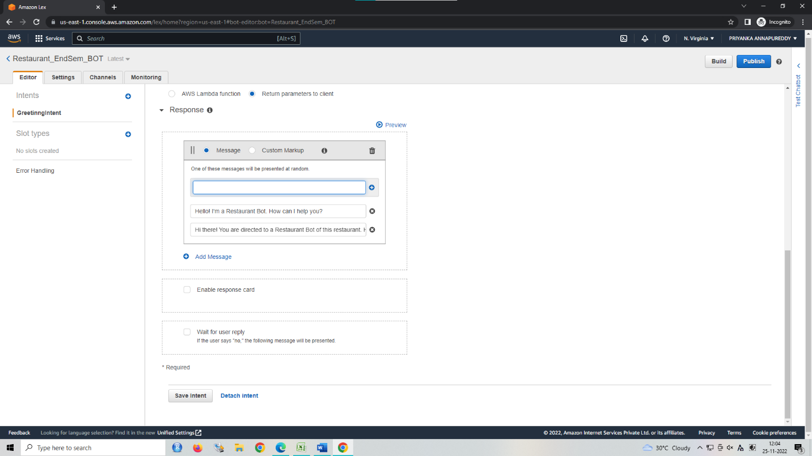
We can give the reply to the user using lambda or directly using amazon lex. In response, click on add message and
type the response given by the bot.
Click on save intent and then click on Build. You can test the responses of the bot using Test ChatBot in the right panel.

Slide 9
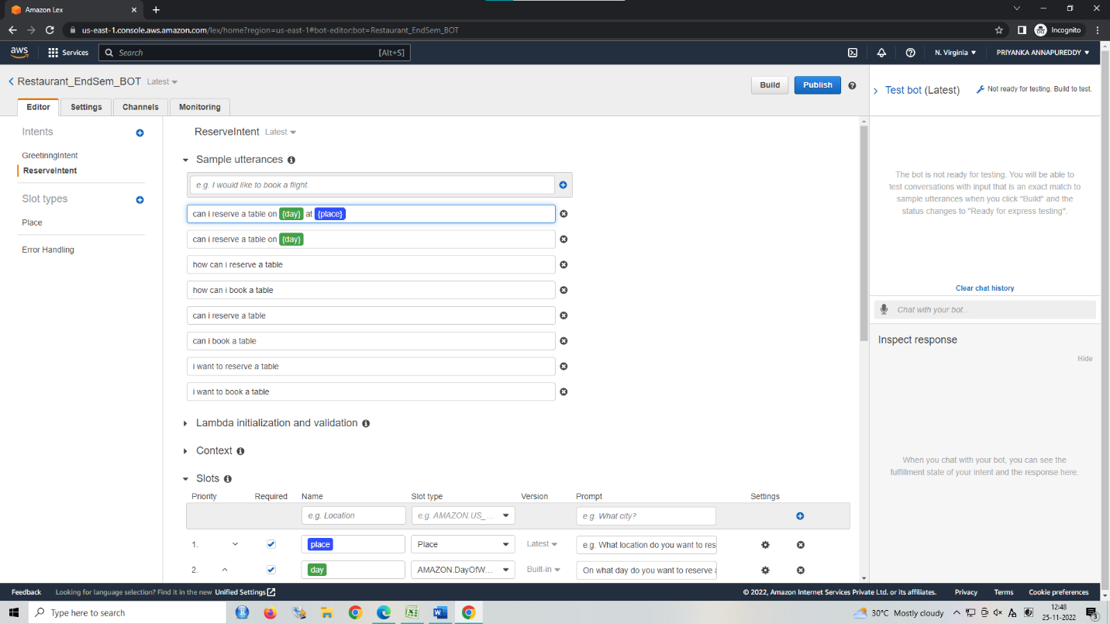
Similarly, we need to create other intents like ReservationIntent, ConfirmationIntent, ConclusionIntent and many more

Slide 10
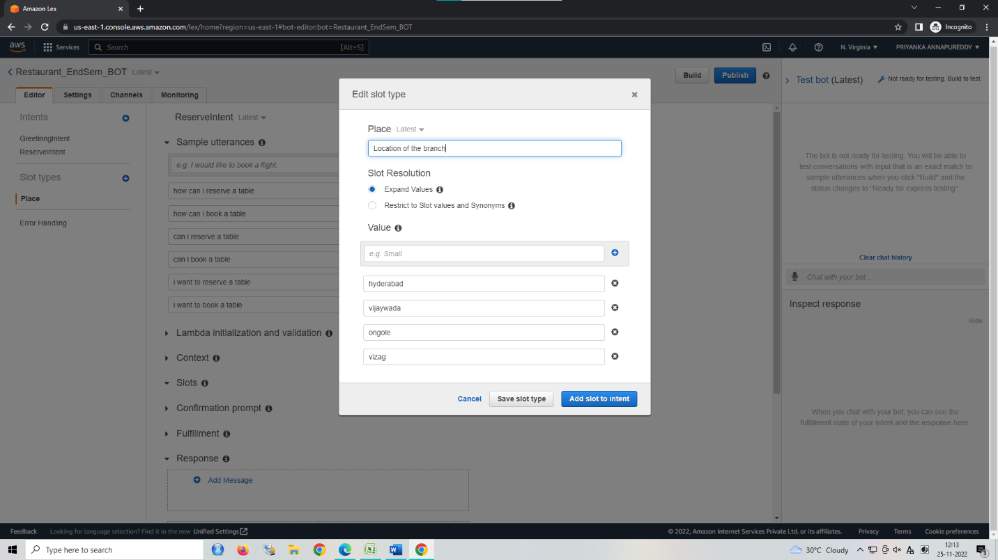

Slide 11
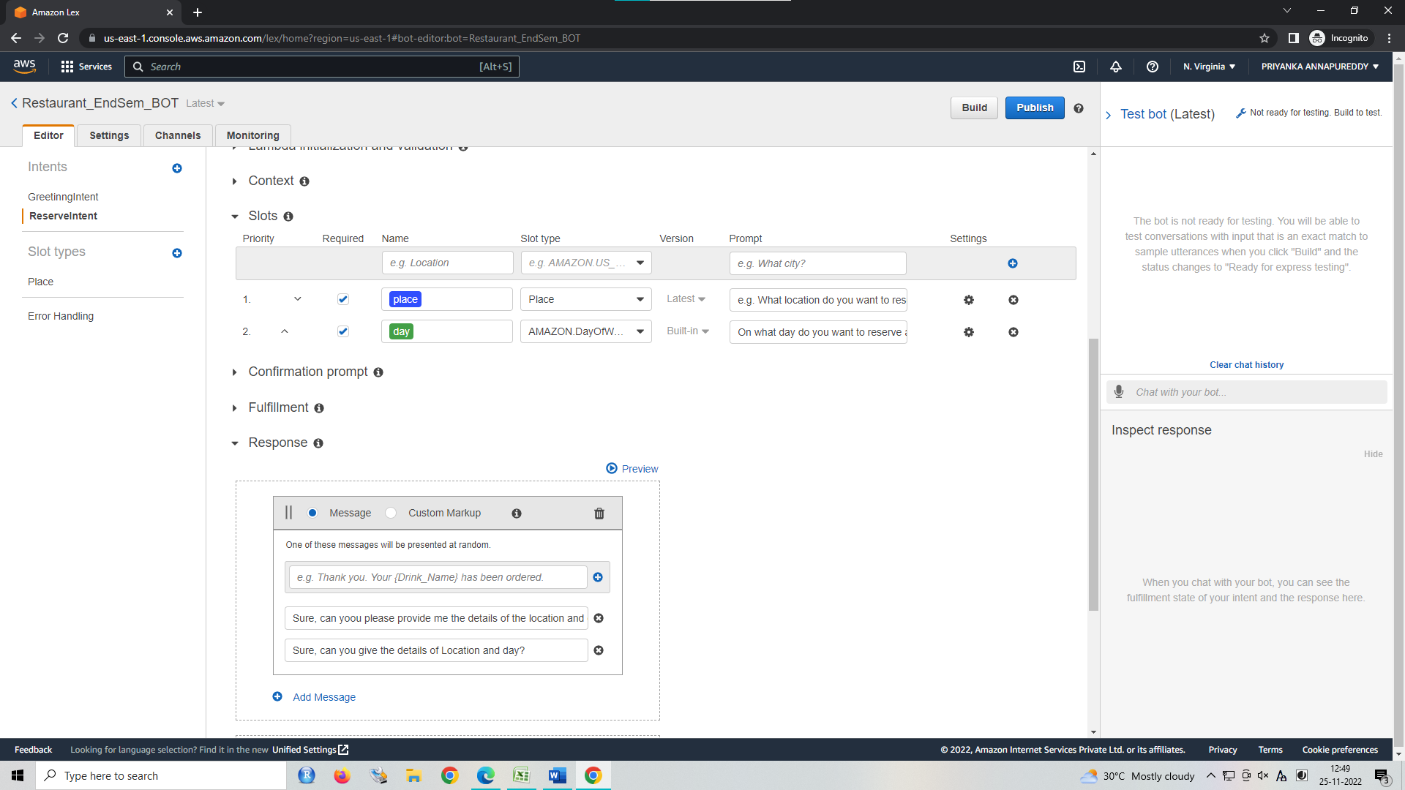

Slide 12
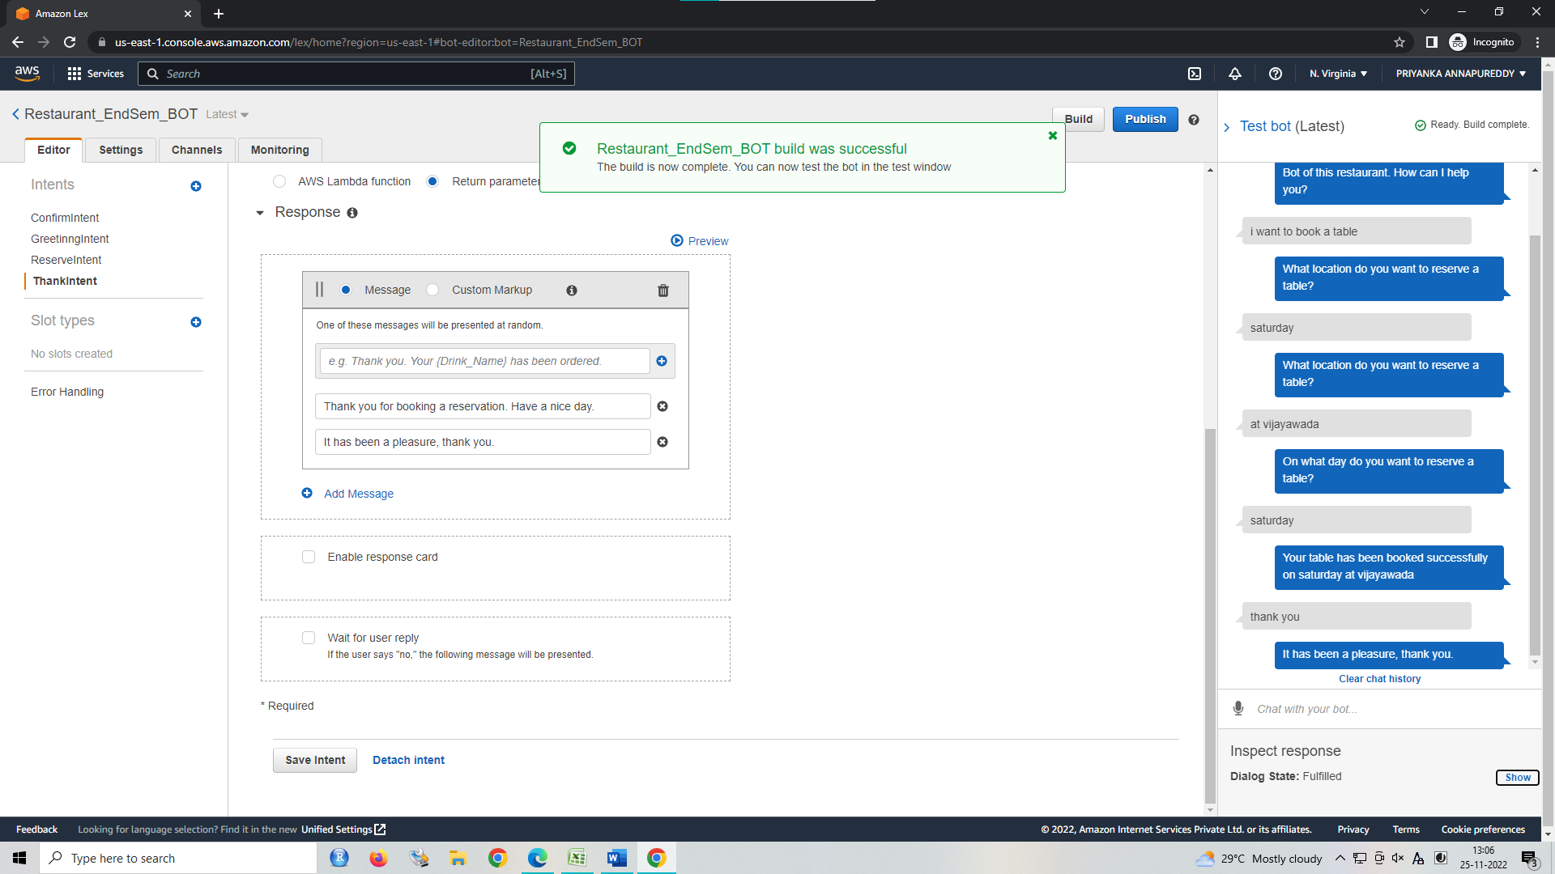

Slide 13
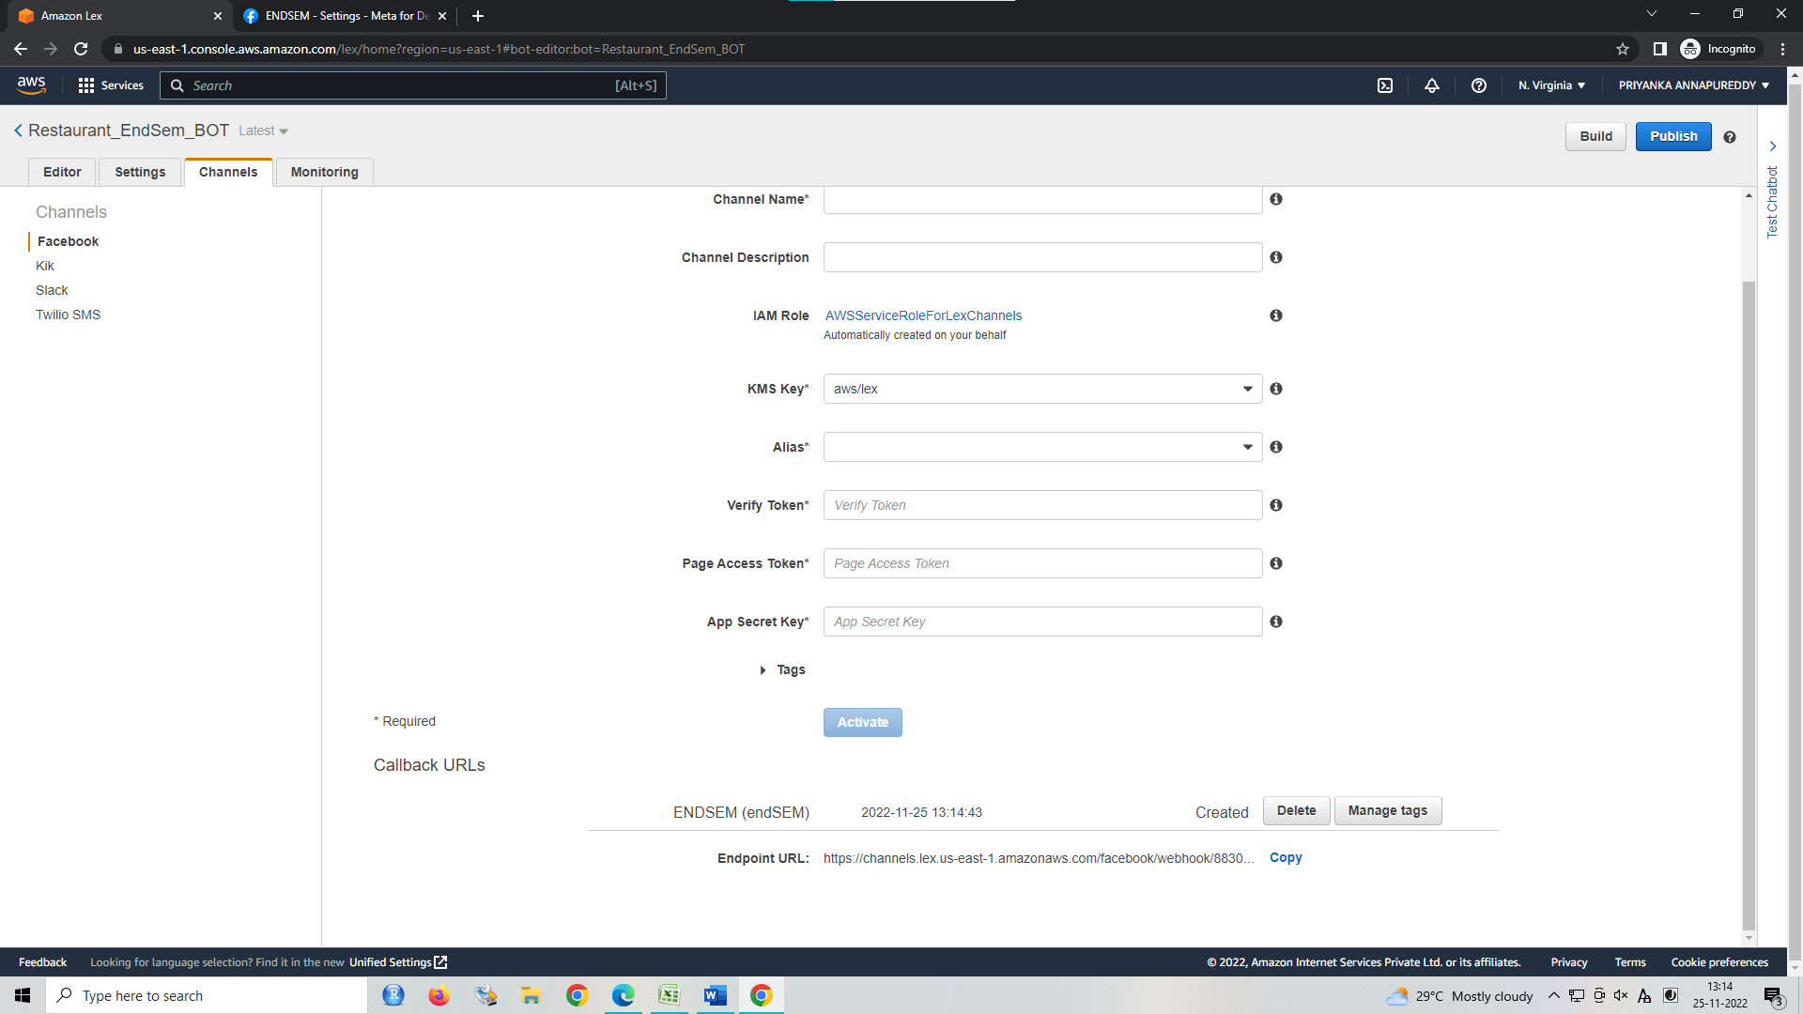
After verifying, click on publish on the top right, give a name to the bot & alias name, and then click on go to channels. Click on activate and copy the url given below.
Now, open developers.facebook.com and then login with your Facebook account > My Apps > Create app

Slide 14
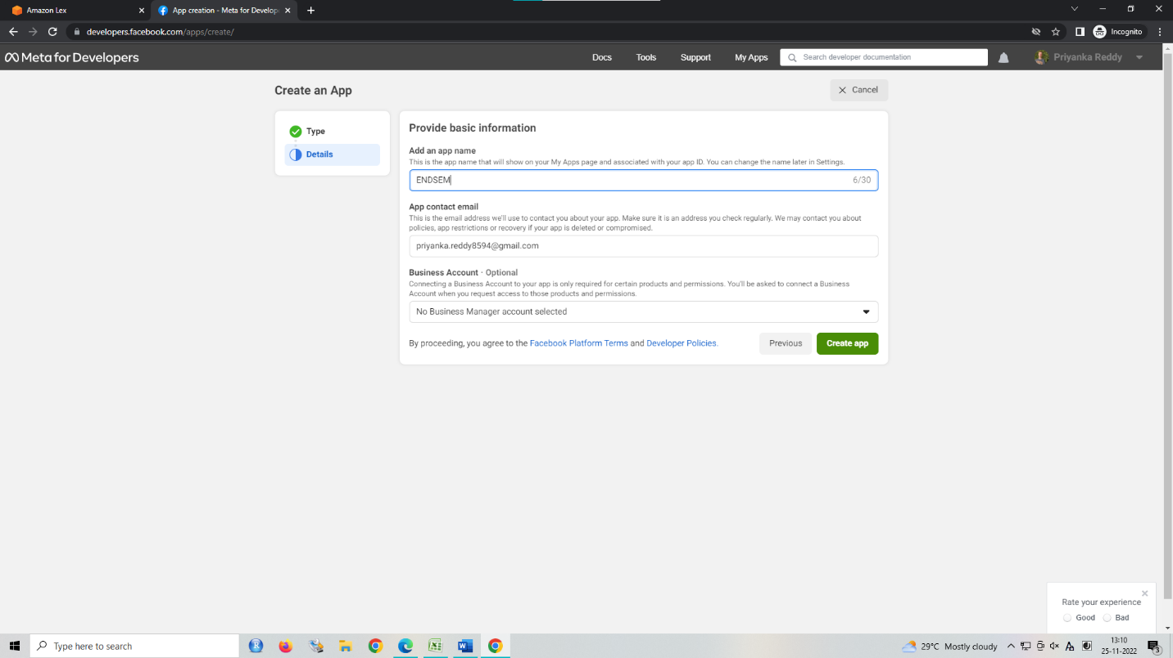

Slide 15
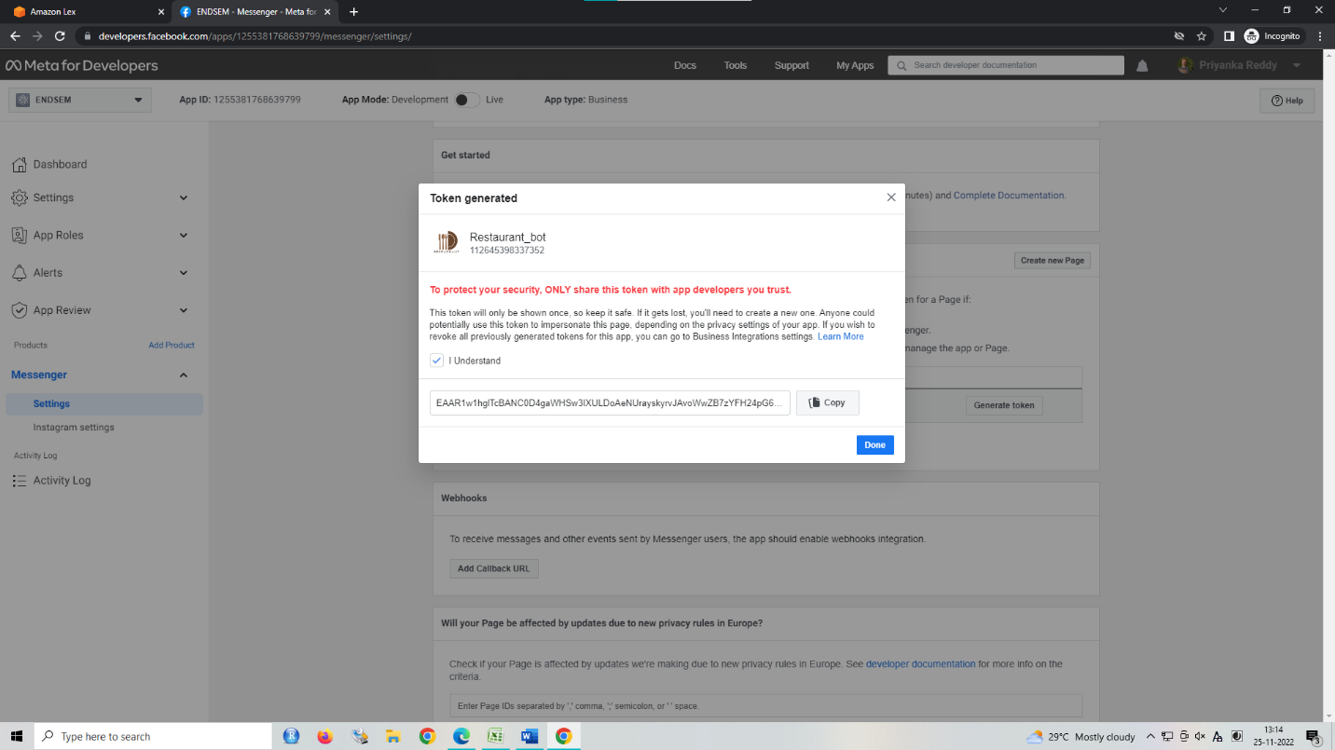
Select Business in type and app name in details
In products, click on set up for messenger application. In Access Token section click on add/remove pages. Above copied link should be pasted in the Webhooks > add callback url.

Slide 16
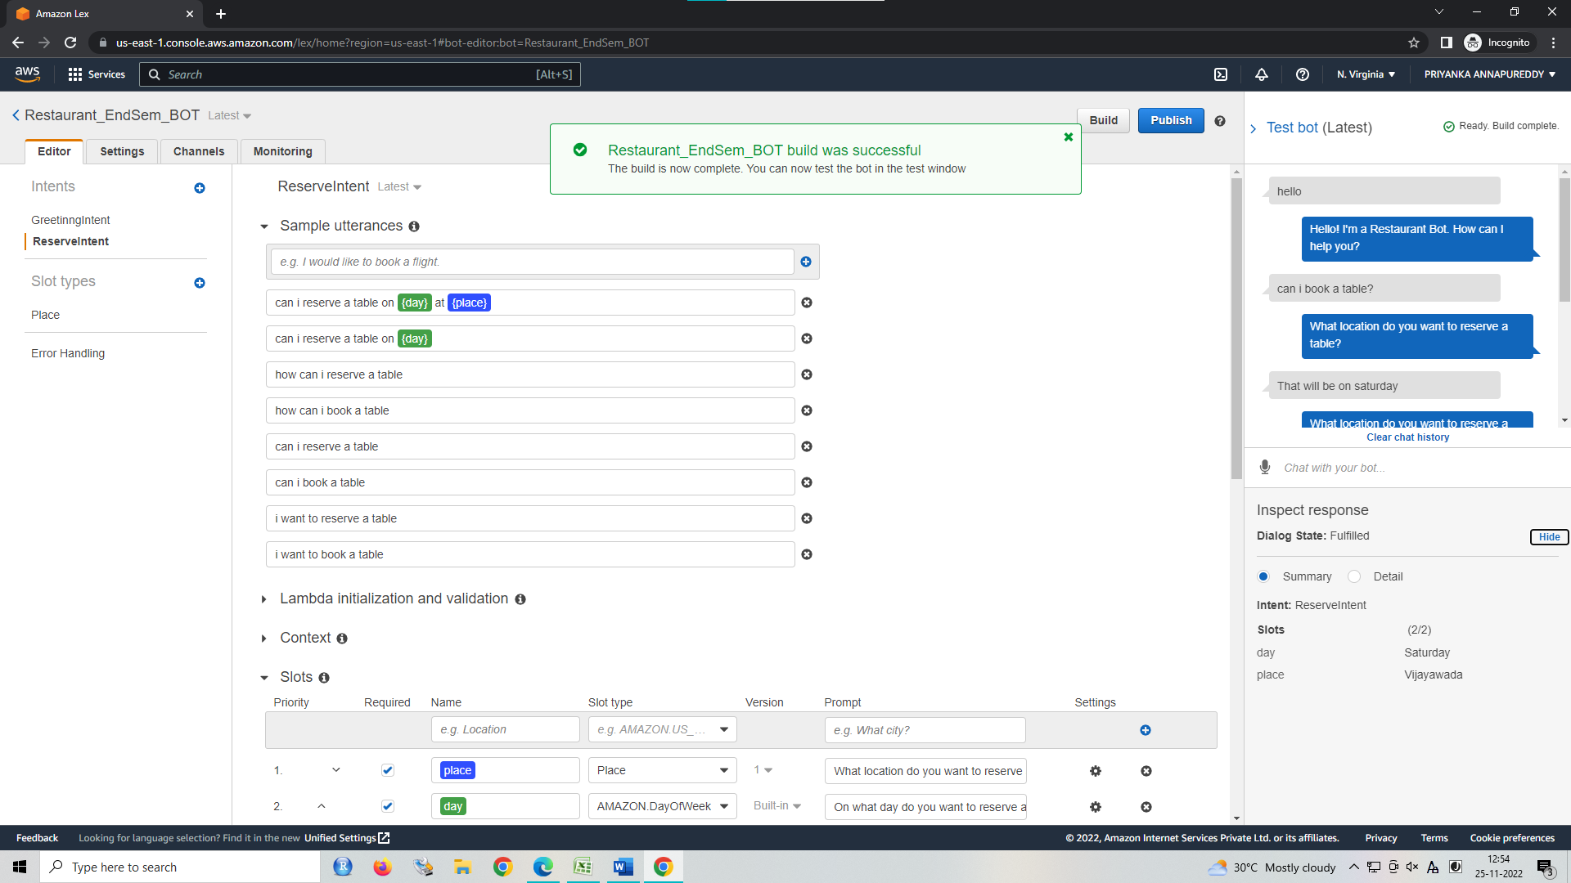
Click on save intent and then click on Build. You can test the responses of the bot using Test ChatBot in the right panel

Slide 17
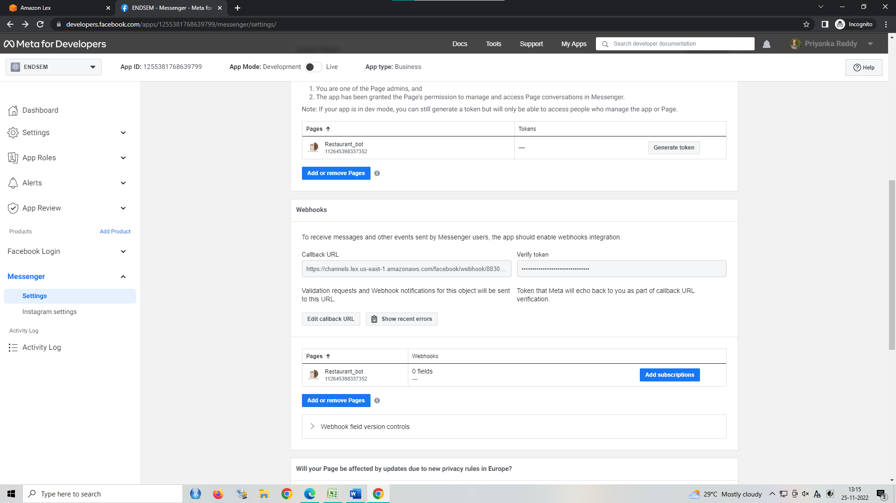
click on add subscription>messages>save

Slide 18
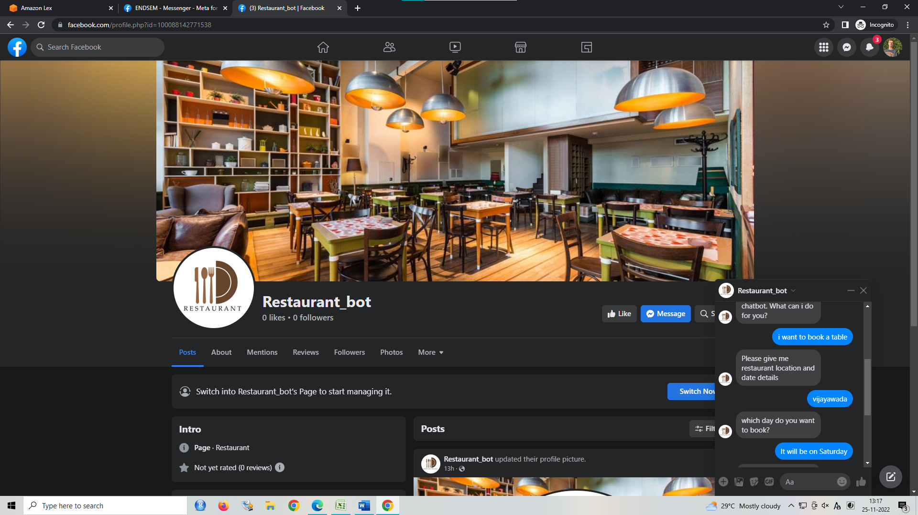
THE CHATBOT IS WORKING SUCCESSFULLY FOR THE FACEBOOK PAGE

Slide 19
THANK YOU

